Slide 1
Coastal Threat Alert System: AI/ML-Powered Early Warning Platform

Slide 2
Contents
Problem Statement
Motivation and Impact
Stakeholders and Users
Solution Overview
Core Features
System Architecture and Workflow
Technology Stack
AI/ML Details
Implementation Plan
Impact Evaluation
Demo and Use Case
Future Enhancements
Conclusion

Slide 3
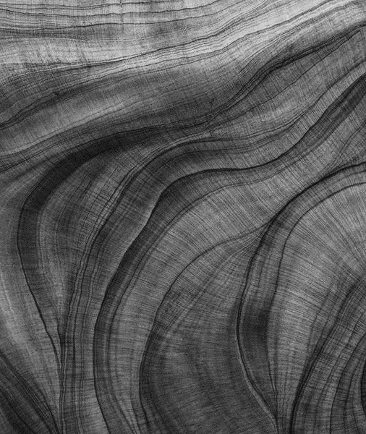
Problem Statement
Coastal regions face increasing threats: storm surges, coastal erosion, algal blooms, illegal dumping, and cyclonic activity.
Timely data-driven intervention is crucial for saving lives, property, and blue carbon habitats.

Slide 4
Motivation & Impact
Protects human lives and assets from sudden disasters
Preserves coastal ecosystems vital for climate and biodiversity
Empowers communities and authorities for sustainable management.

Slide 5

Stakeholders & Users
Disaster management agencies | City and state governments
Coastal communities (fisherfolk, residents) | Environmental NGOs and civil defense teams

Slide 6
Solution Overview
AI-powered, multi-source early warning and alert platform
Real-time data fusion, anomaly detection, and threat prediction
Actionable alerts to authorities and exposed communities via SMS, app, and dashboard

Slide 7
Core Features
Data ingestion from sensors (tide gauges), satellite feeds, and weather data
AI/ML models analyze trends and detect anomalies in real time
Multi-channel alert distribution: SMS, push notifications, web dashboards
Action history and feedback collection for continuous improvement

Slide 8
System Architecture & Workflow
Data pipeline: sensors & APIs → central server → AI/ML analysis
Alert engine: interprets model outputs, triggers notifications
User interfaces: intuitive dashboards for authorities, mobile app for public notifications

Slide 9









Technology Stack
Satellite and Analysis:
Prototype (Google Earth Engine)
A cloud-based geospatial analysis platform. Fetches and processes satellite imagery (e.g., Sentinel-2, Landsat) to detect changes in AOIs using advanced algorithms.
ML Implementation (Static Working):
1. Data Acquisition • ISRO LISS-4 (Bands 2, 3, 4: Green, Red, NIR) • Source: Bhoonidhi (GeoTIFF, Multi-temporal – T1 & T2)
2. AOI Handling • User-defined GeoJSON from frontend • Stored in MongoDB • Used for raster clipping
3. Image Preprocessing • Tools: rasterio, geopandas, numpy • Clipping, Normalization, Basic Cloud Masking
4. Change Detection • NDVI Calculation & Differencing (ΔNDVI) • Band-wise Differencing • Optional: K-Means Clustering (scikit-learn)
5. Thresholding & Filtering • User-defined threshold (30%–90%) • Noise removal via morphological filtering
Frontend:
React
Typescript
Tailwind
Leaflet
Database:
MongoDB
Redis
Backend:
FastAPI
Celery
Redis
Notifications:
Twilio,
SendGrid
Datasets and APIs: NOAA
Ocean & Coasts | National Oceanic and Atmospheric Administration

Slide 10
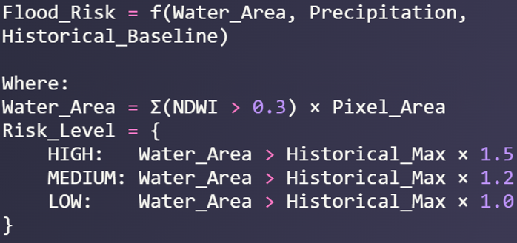


AI/ML/DL Details and Formulas
Normalized Difference Vegetation Index (NDVI): NDVI = (NIR - Red) / (NIR + Red)
NIR = Near Infrared band (Band 8 in Sentinel-2)
Red = Red band (Band 4 in Sentinel-2)
2. NDVI Change Detection Formula: ΔNDVI = NDVI(t₂) - NDVI(t₁)
NDVI(t₂) = NDVI at time period 2 (recent)
NDVI(t₁) = NDVI at time period 1 (baseline)
1. Flood Risk Assessment:
3. Pixel Area Calculation: Area = Σ(Pixel_Area × Change_Mask)
Pixel_Area = ee.Image.pixelArea() (in square meters)
Change_Mask = Binary mask of significant changes
4. Cloud Masking Algorithm: Cloud_Mask = (QA60 & 2¹⁰ = 0) AND (QA60 & 2¹¹ = 0)
QA60 = Quality Assessment band
2¹⁰ = Cloud bit mask (1024)
2¹¹ = Cirrus cloud bit mask (2048)
2. Temporal Composite Median Filter:
3. Spatial Resolution Scale Factor
AOI Change Flood detection

Slide 11
Implementation Plan
Phase | Plan
Phase 1 | Build data ingestion and management pipeline
Phase 2 | Develop and train AI/ML models
Phase 3 | Integrate alert engine and notification systems
Phase 4 | Test with simulated and real datasets, gather feedback

Slide 12
Impact Evaluation
KPIs: number of timely alerts, lives/assets saved, reduction in response time, habitat protection metrics
Community and authority feedback loops for continuous improvemen

Slide 13
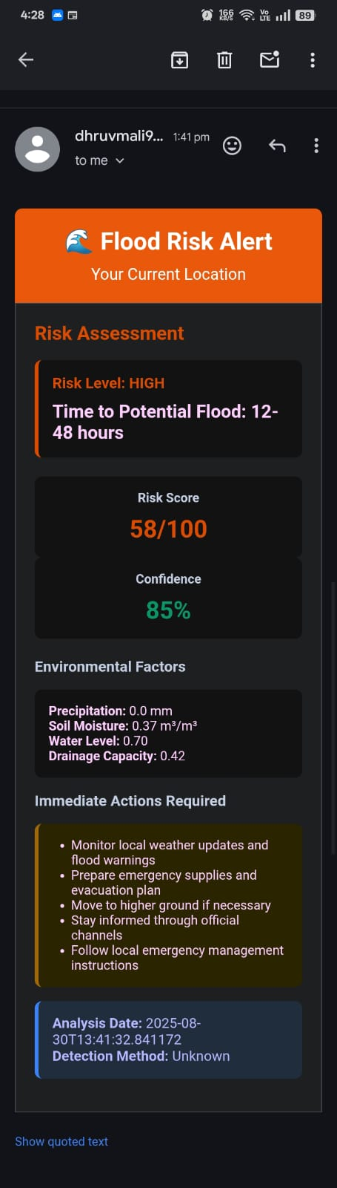
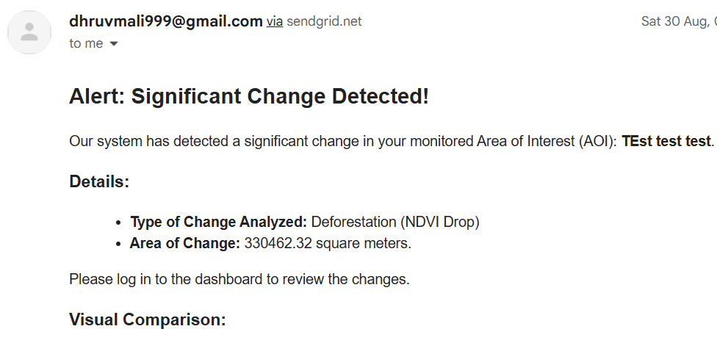
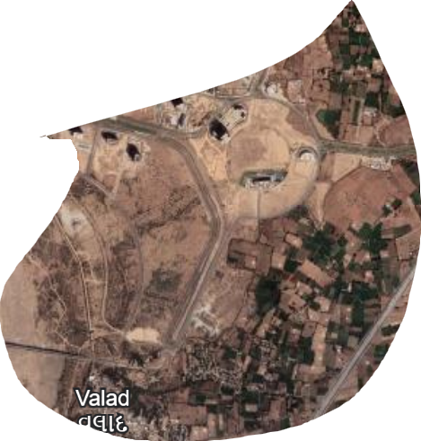
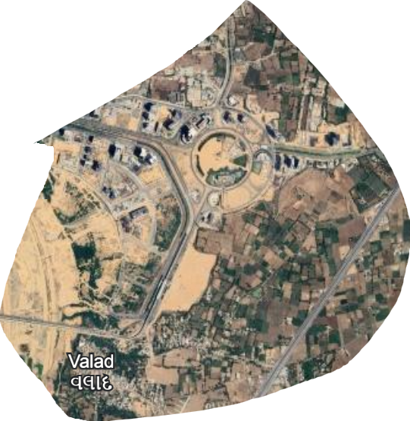
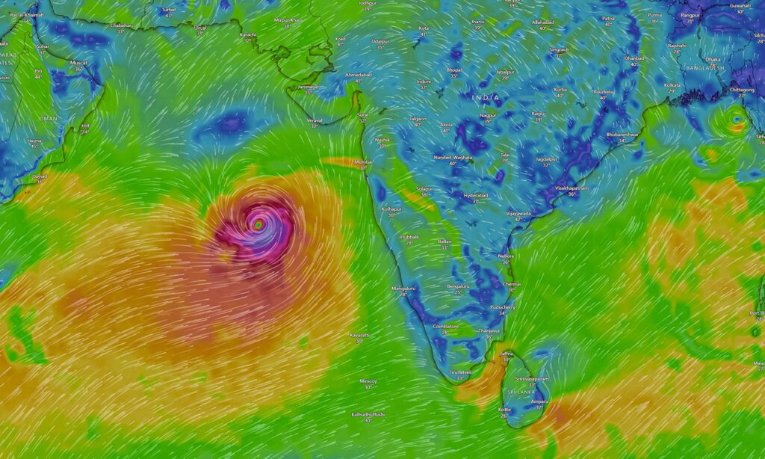
Output Diagrams
After
Deforestation

Slide 14
Future Enhancements
Expand coverage to more coastal threats
Deep learning for richer pattern analysis
Integration with international disaster response frameworks

Slide 15
Conclusion
Comprehensive, scalable, AI-driven solution for coastal safety
Potential to transform disaster preparedness and environmental protection

